Slide 1



Analysis of AtliQ Mart
Domain: FMCG Function: Sales / Promotions
AtliQ Mart is a retail giant with over 50 supermarkets in the southern region of India. All their 50 stores ran a massive promotion during the Diwali 2023 and Sankranti 2024 (festive time in India) on their AtliQ branded products.
Now the sales director wants to understand which promotions did well and which did not so that they can make informed decisions for their next promotional period

Slide 2
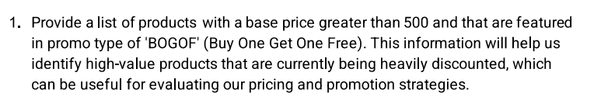

Business Request
SELECT product_name AS Product_With_PromoType_BOGOF_AND_Price_Higherthan_500
FROM dim_products
WHERE product_code IN
( SELECT product_code FROM fact_events
WHERE base_price > 500 AND promo_type = 'BOGOF' )

Slide 3
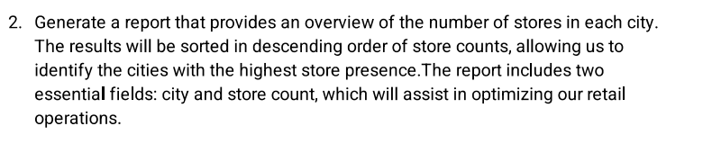
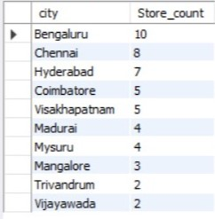
Business Request
SELECT city ,
COUNT(store_id) AS Store_count
FROM dim_stores
GROUP BY city
ORDER BY COUNT(store_id) DESC

Slide 4
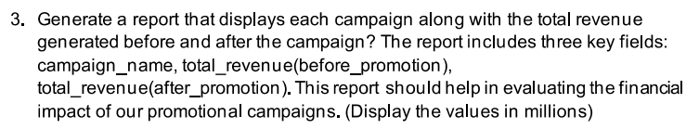

Business Request
SELECT campaign_name ,
CONCAT ( round(SUM(Revenue_before_promo) / 1000000.0) ,' M' ) AS Total_Revenue_before_promo ,
CONCAT ( round(SUM(Revenue_after_promo) / 1000000.0) ,' M' ) AS Total_Revenue_after_promo
FROM fact_events AS fe
JOIN dim_campaigns AS dc
ON fe.campaign_id = dc.campaign_id
GROUP BY campaign_name;

Slide 5
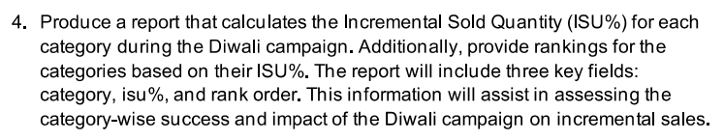
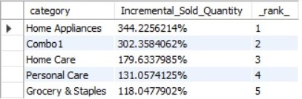
Business Request
CREATE TABLE temp_category_summary AS
SELECT category ,
sum(`quantity_sold(after_promo) `) AS Total_SAP ,
sum(`quantity_sold(before_promo) `) AS Total_SBP
FROM fact_events AS fe
JOIN dim_products AS dp
ON fe.product_code = dp.product_code
WHERE campaign_id = "CAMP_DIW_01"
GROUP BY category;
ALTER TABLE temp_category_summary
ADD COLUMN ISU float8;
UPDATE temp_category_summary
SET ISU = ((Total_SAP / Total_SBP) * 100);
SELECT
category ,
CONCAT ( ISU ,'%' ) AS Incremental_Sold_Quantity ,
RANK() OVER ( ORDER BY ISU DESC ) AS _rank_
FROM temp_category_summary

Slide 6
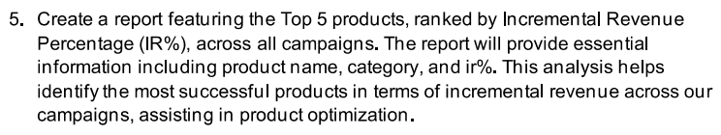
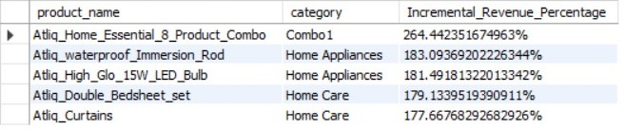
Business Request
CREATE TABLE temp_product_summary AS
SELECT product_name ,
SUM(Revenue_before_promo) AS Total_RBP ,
SUM(Revenue_after_promo) AS Total_RAP
FROM fact_events AS fe
JOIN dim_products AS dp
ON fe.product_code = dp.product_code
GROUP BY product_name;
ALTER TABLE temp_product_summary
ADD COLUMN IRP float8;
UPDATE temp_product_summary
SET IRP = ((Total_RAP / Total_RBP) * 100);
SELECT tps.product_name ,category ,
CONCAT ( IRP ,'%' ) AS Incremental_Revenue_Percentage
FROM temp_product_summary AS tps
JOIN dim_products AS dp
ON tps.product_name = dp.product_name
ORDER BY IRP DESC LIMIT 5

Slide 7
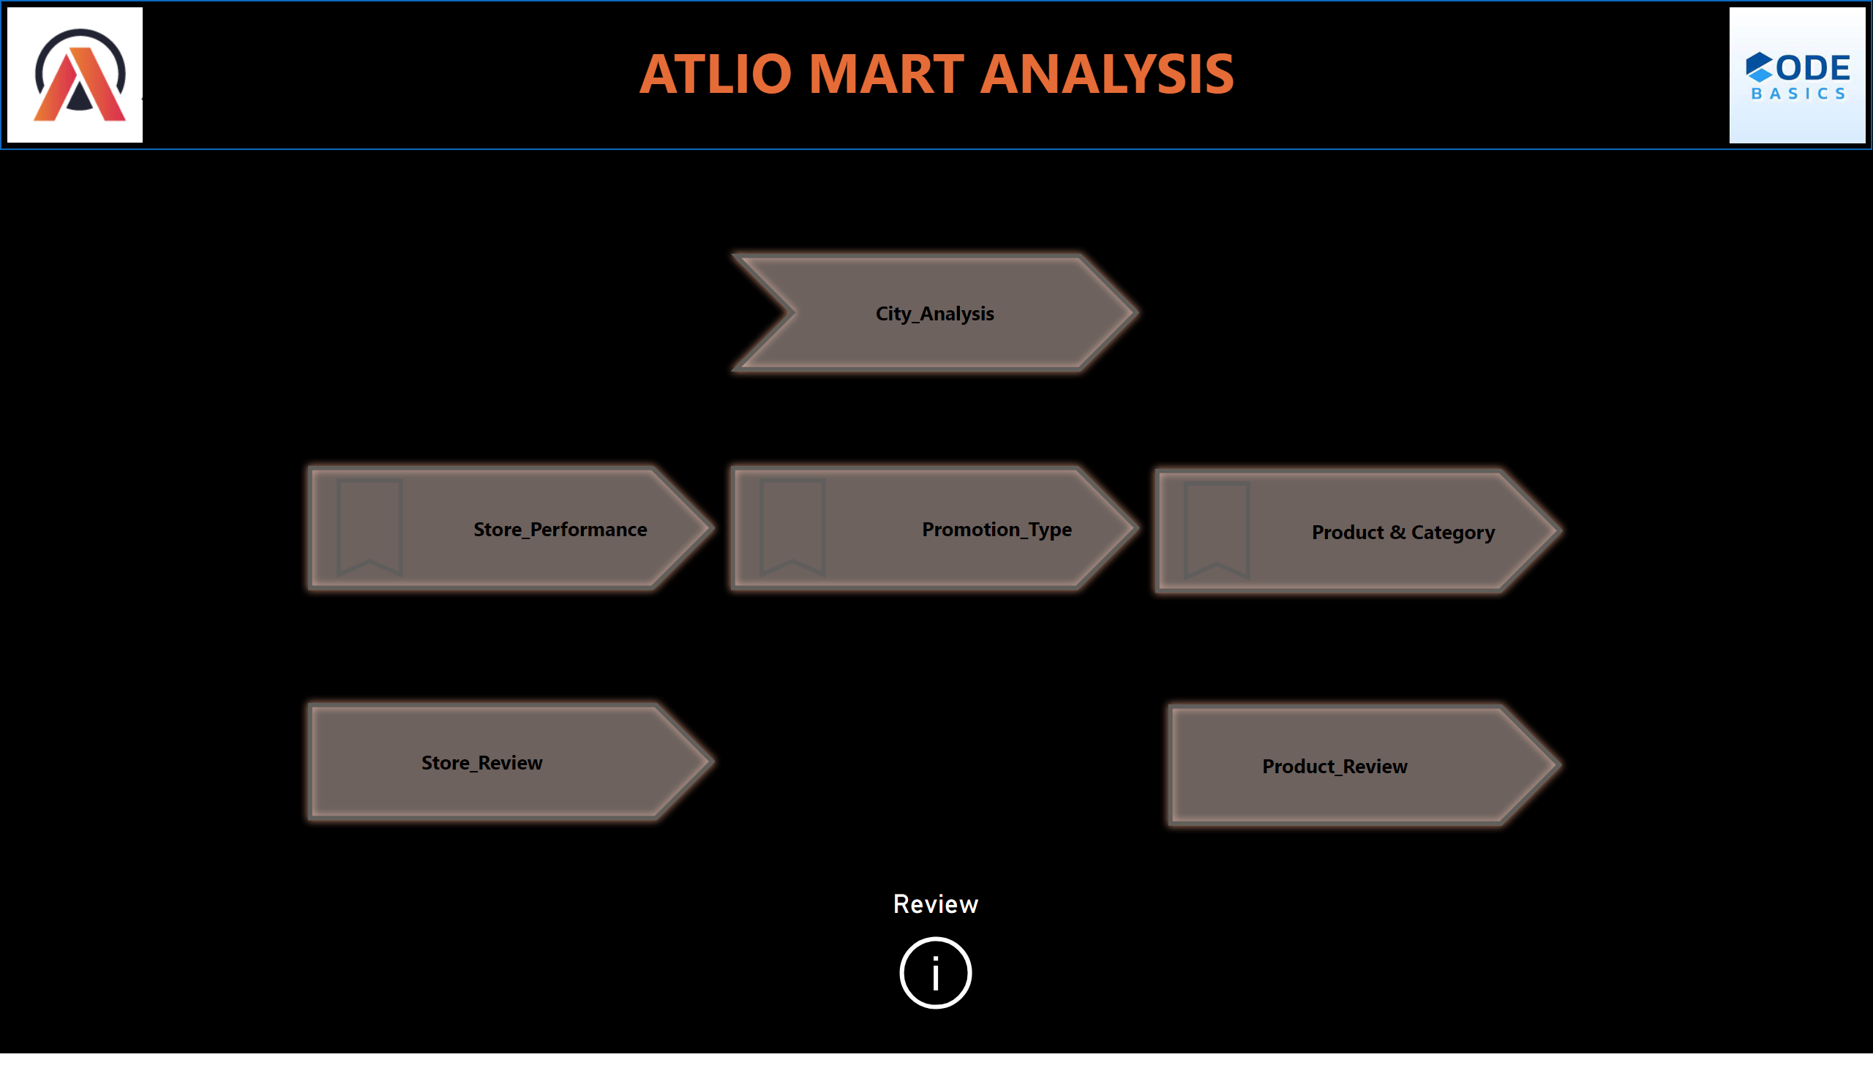
Home Page
Notes:
actionButton
No alt text provided
actionButton
No alt text provided
actionButton
No alt text provided
shape
No alt text provided
textbox
No alt text provided
image
No alt text provided
image
No alt text provided
actionButton
No alt text provided
actionButton
No alt text provided
Review
No alt text provided
actionButton
No alt text provided

Slide 8
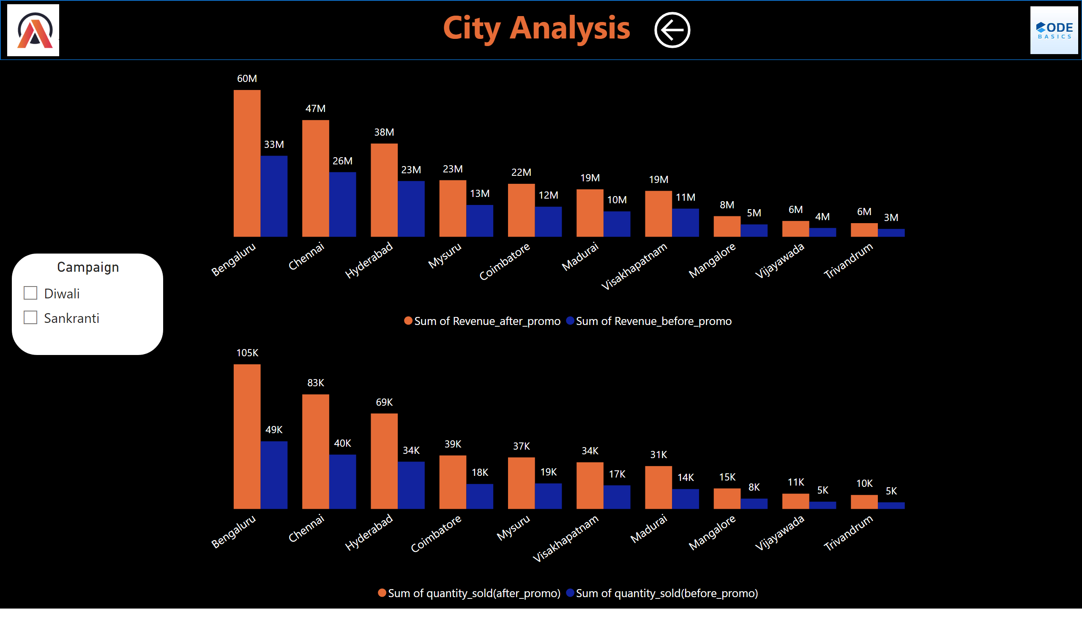
City
Notes:
image
No alt text provided
image
No alt text provided
textbox
No alt text provided
shape
No alt text provided
Revenue_after_Promo
No alt text provided
Revenue_after_Promo
No alt text provided
Campaign
No alt text provided
actionButton
No alt text provided

Slide 9
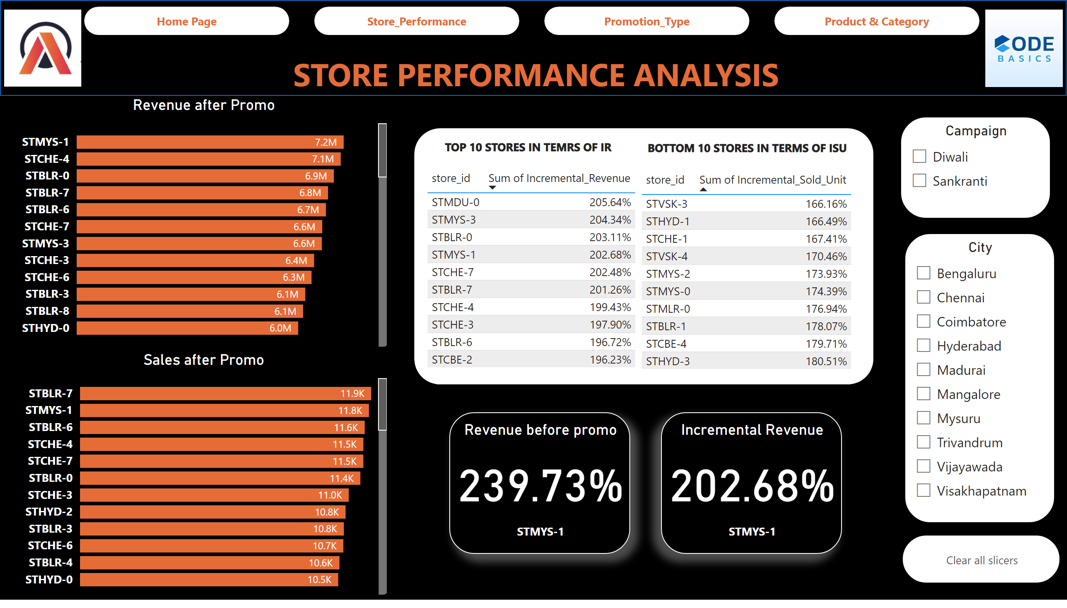
Store_Performance
Notes:
shape
No alt text provided
textbox
No alt text provided
pageNavigator
No alt text provided
image
No alt text provided
image
No alt text provided
tableEx
No alt text provided
tableEx
No alt text provided
textbox
No alt text provided
textbox
No alt text provided
shape
No alt text provided
Revenue after Promo
No alt text provided
shape
No alt text provided
Revenue before promo
No alt text provided
Incremental Revenue
No alt text provided
actionButton
No alt text provided
Campaign
No alt text provided
City
No alt text provided
Sales after Promo
No alt text provided

Slide 10
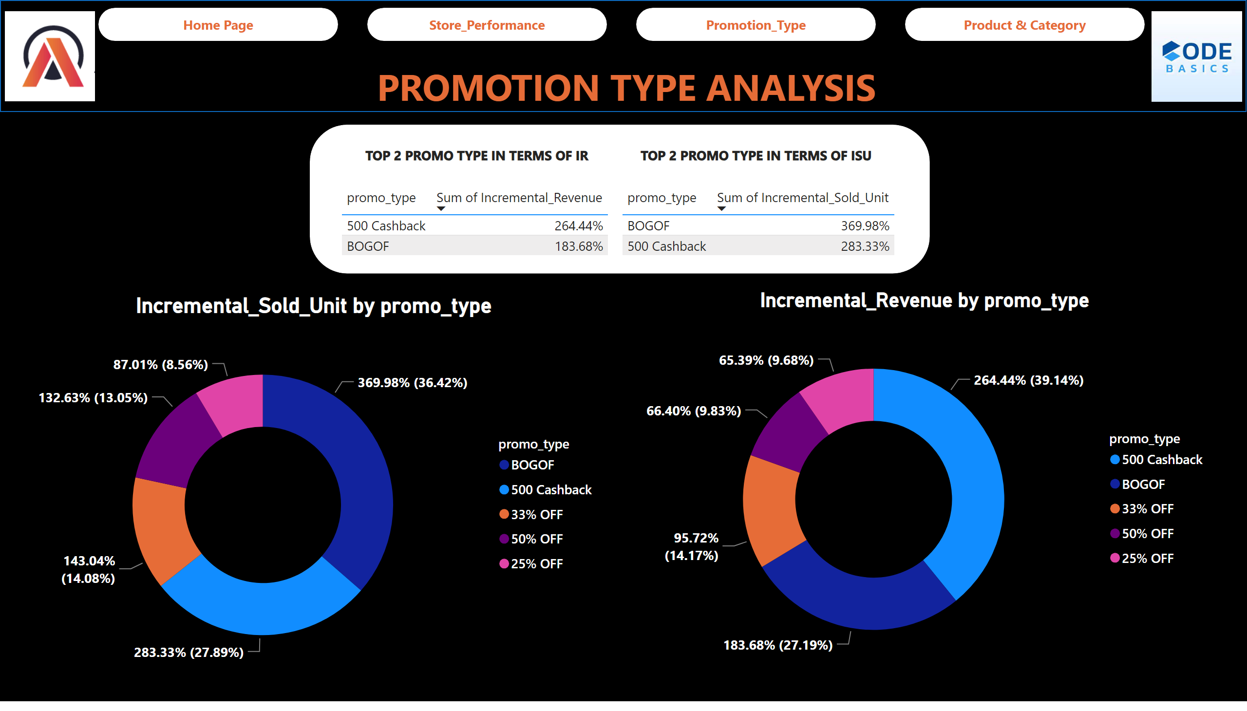
Promotion_Type
Notes:
shape
No alt text provided
tableEx
No alt text provided
tableEx
No alt text provided
textbox
No alt text provided
textbox
No alt text provided
Incremental_Sold_Unit by promo_type
No alt text provided
shape
No alt text provided
Incremental_Revenue by promo_type
No alt text provided
shape
No alt text provided
shape
No alt text provided
textbox
No alt text provided
pageNavigator
No alt text provided
image
No alt text provided
image
No alt text provided

Slide 11
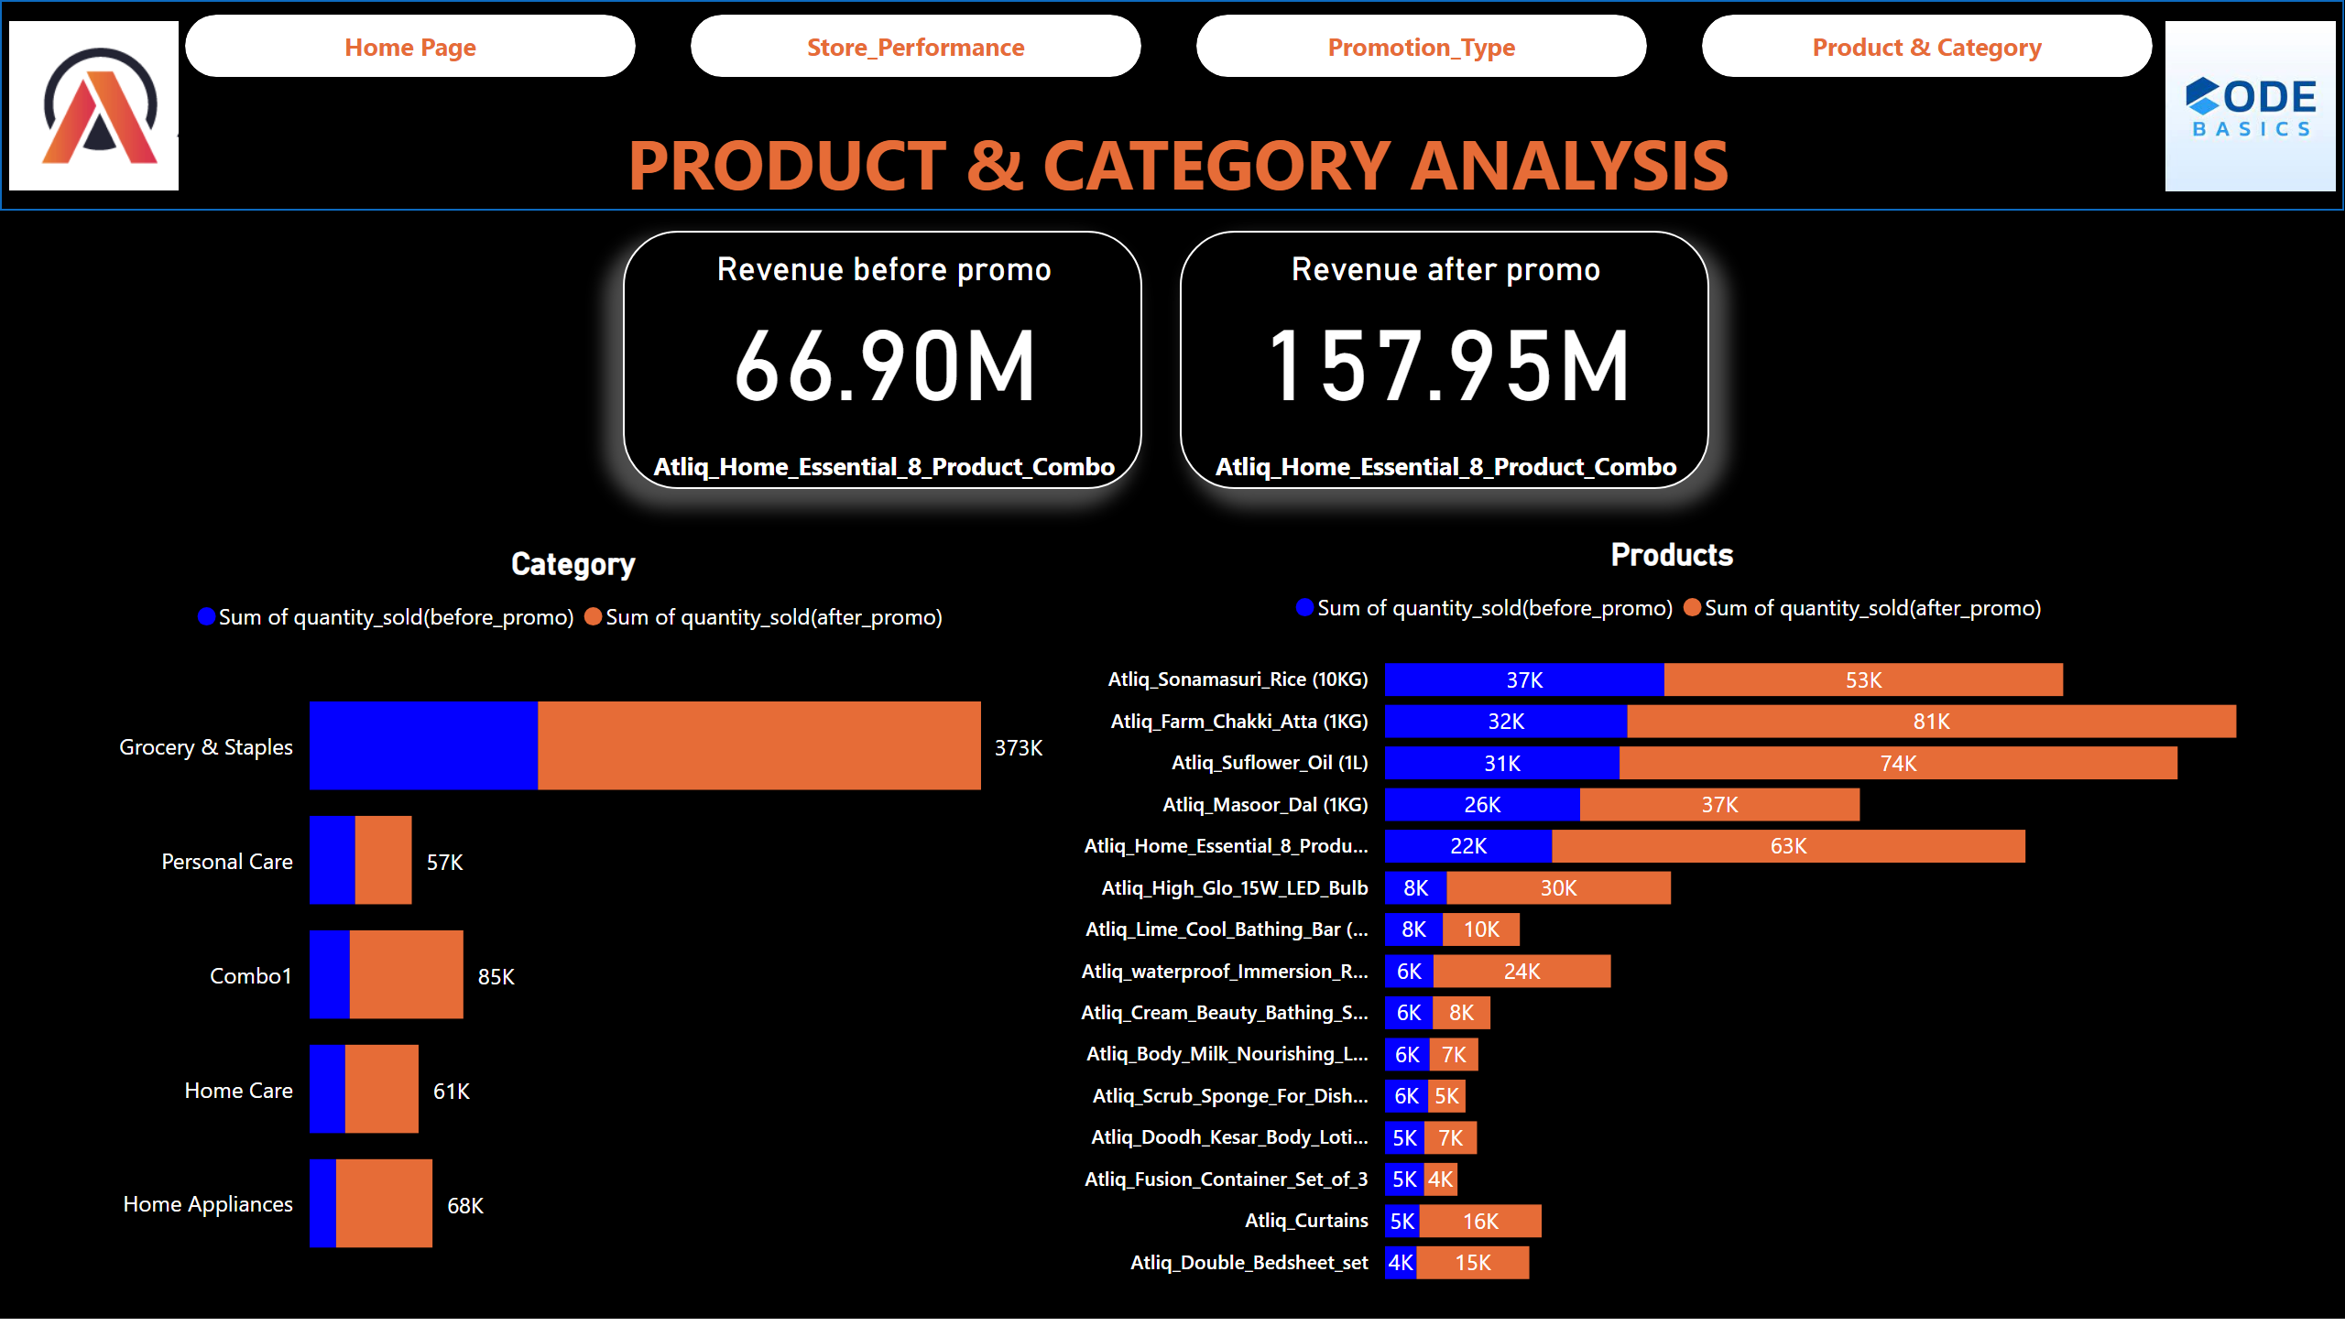
Product & Category
Notes:
Category
No alt text provided
Products
No alt text provided
shape
No alt text provided
Revenue after promo
No alt text provided
Revenue before promo
No alt text provided
shape
No alt text provided
textbox
No alt text provided
pageNavigator
No alt text provided
image
No alt text provided
image
No alt text provided

Slide 12
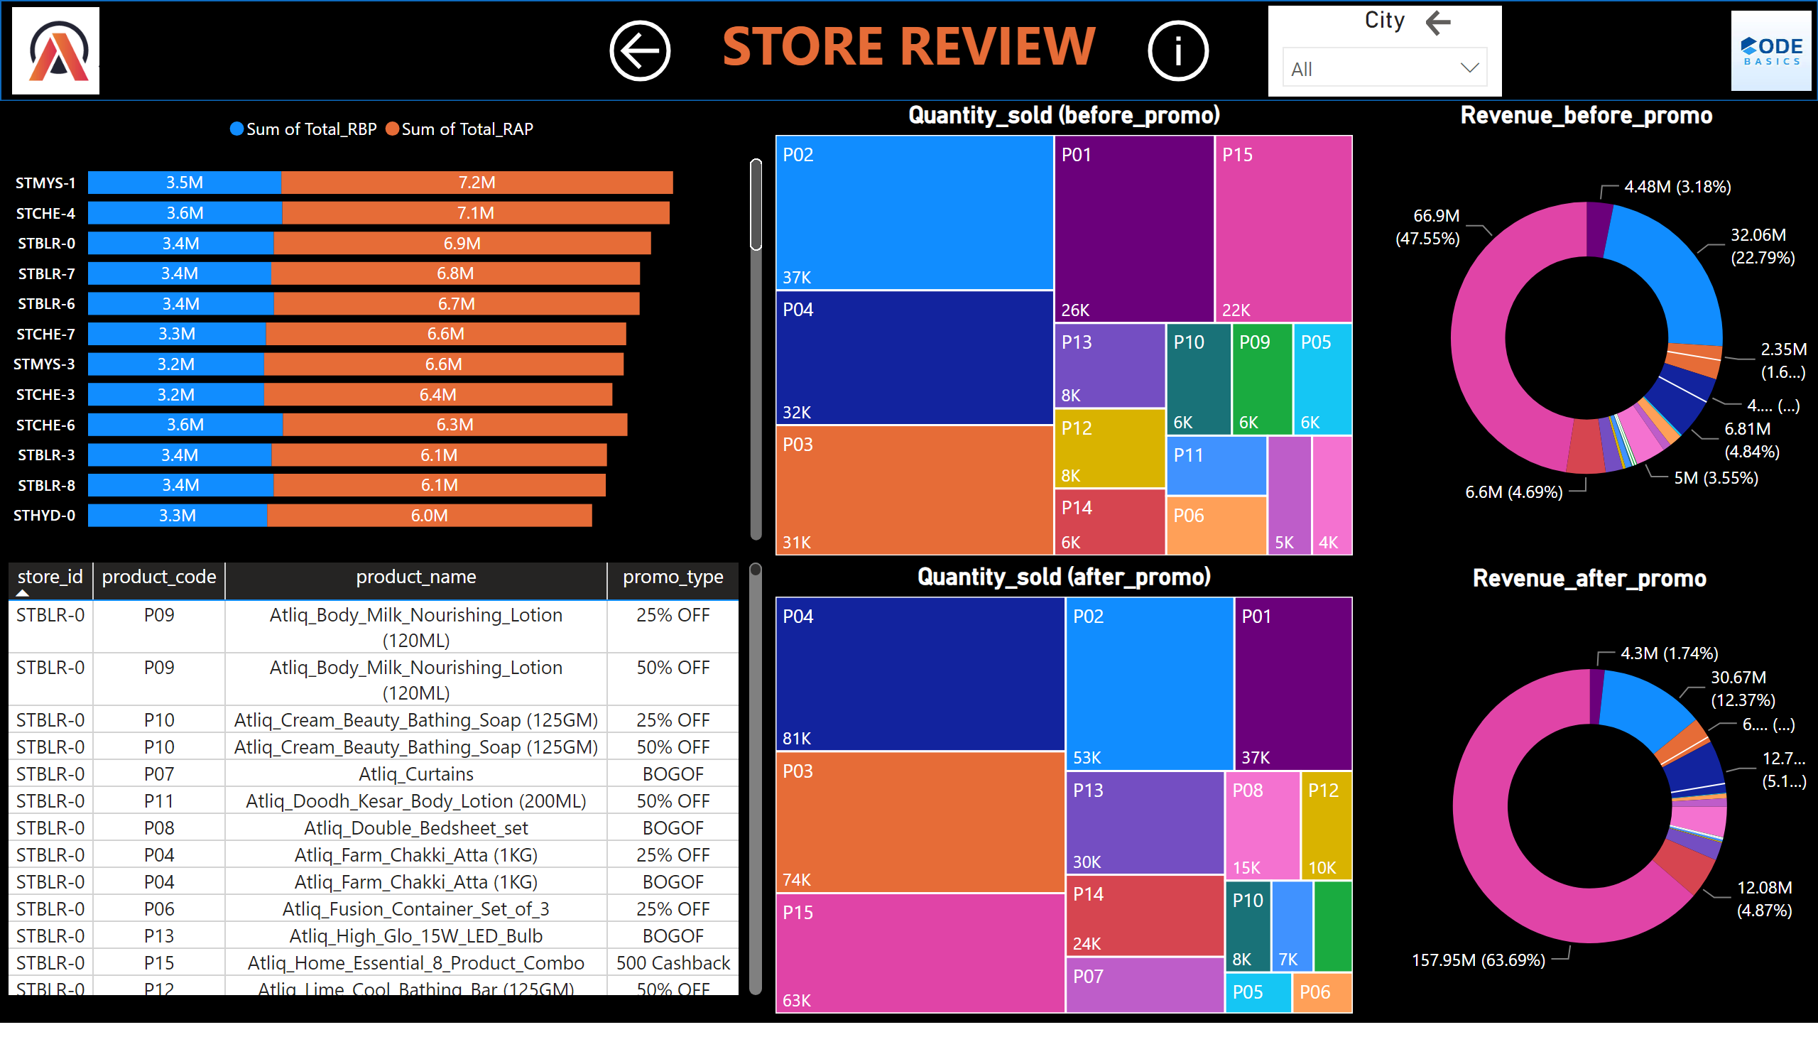
Store_Review
Notes:
barChart
No alt text provided
tableEx
No alt text provided
Quantity_sold (after_promo)
No alt text provided
Quantity_sold (before_promo)
No alt text provided
image
No alt text provided
image
No alt text provided
textbox
No alt text provided
shape
No alt text provided
actionButton
No alt text provided
Revenue_after_promo
No alt text provided
Revenue_before_promo
No alt text provided
actionButton
No alt text provided
actionButton
No alt text provided
City
No alt text provided

Slide 13
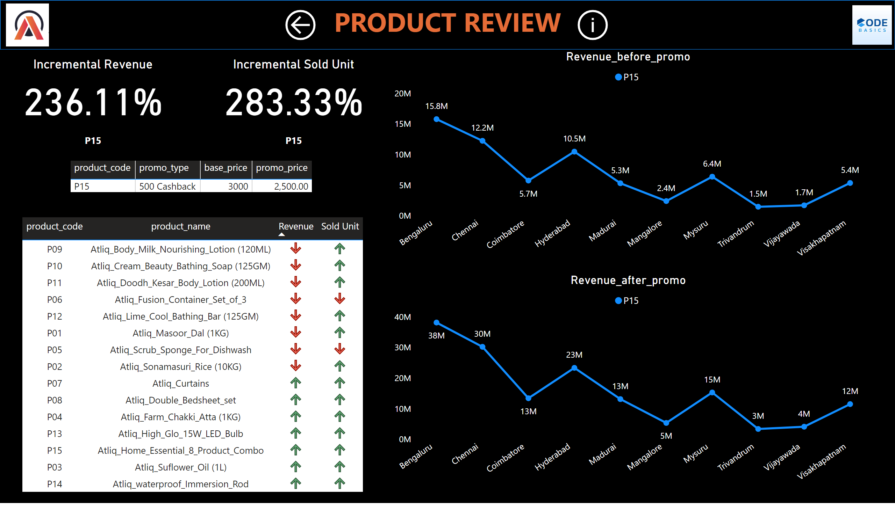
Product_Review
Notes:
image
No alt text provided
image
No alt text provided
textbox
No alt text provided
shape
No alt text provided
actionButton
No alt text provided
tableEx
No alt text provided
tableEx
No alt text provided
Revenue_before_promo
No alt text provided
Revenue_after_promo
No alt text provided
Incremental Revenue
No alt text provided
Incremental Sold Unit
No alt text provided
slicer
No alt text provided
actionButton
No alt text provided
actionButton
No alt text provided

Slide 14
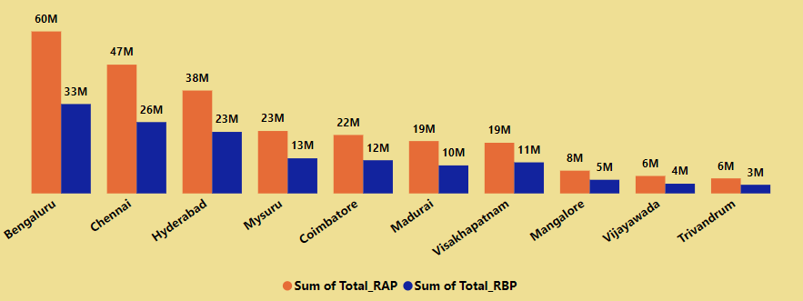
Revenue generated
Bengaluru has the highest revenue before and after the promotions.
Revenue is increased in all the cites after promotions with maximum of 186% in Madurai.

Slide 15
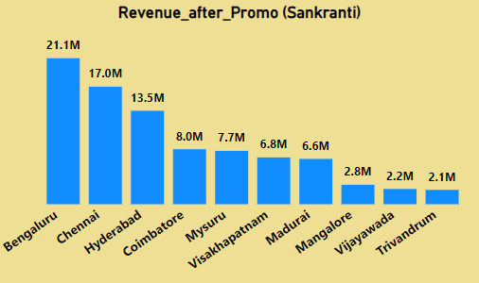

Campaign Impact on Revenue
Diwali campaign has generated more revenue in all the cities over the Sankranti campaign.

Slide 16
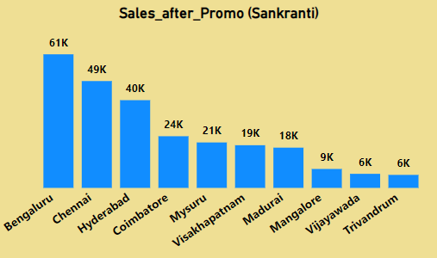
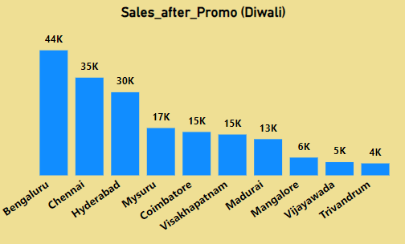
Campaign Impact on Sales
Sankranti campaign has more sales in all the cities over the Diwali campaign.

Slide 17
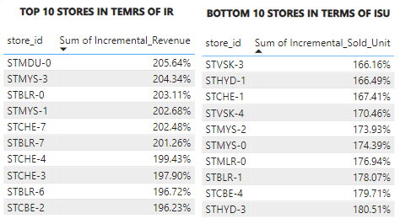
Performance of Stores
Stores with highest Incremental Revenue percentage after promotions
Stores with lowest Incremental Sold Unit Percentage after promotions

Slide 18
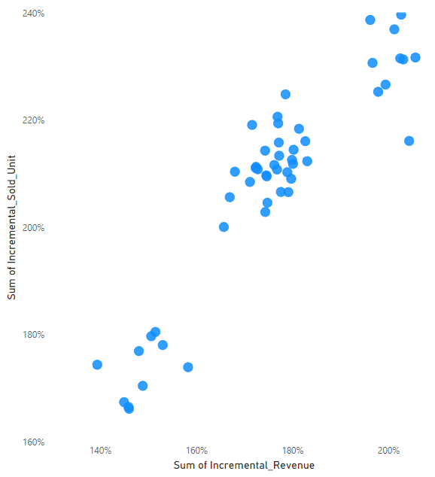
IR vs ISU
Incremental Revenue percentage and Incremental Sold Unit Percentage has a positive correlation

Slide 19
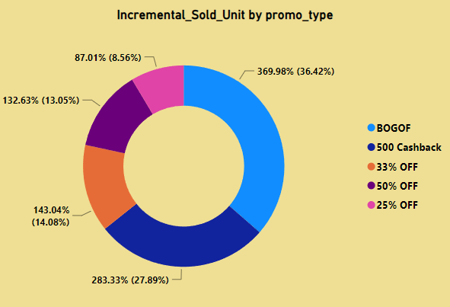
Promotion Insights on Sales
Buy One Get One Free is preferred over a 50% discount, even though both options resulted in the same price.
25% OFF is the least favored promotional offer.

Slide 20
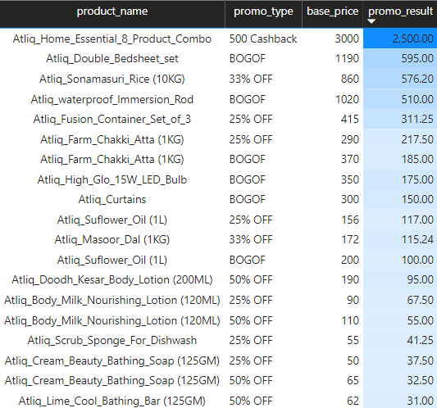
Price Insights
Atliq_Home_Essential_8_Product_Combo, with the highest price, contributes the most to revenue.
The 50% discount on Personal Care Products has a negative impact on revenue after promotions.

Slide 21
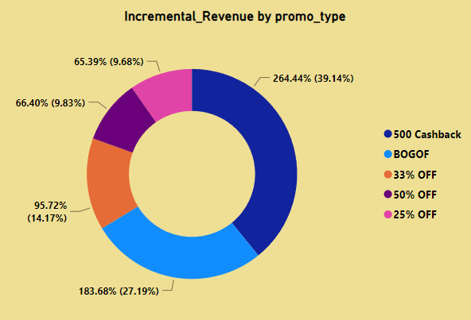
Promotion Insights on Revenue
“500 Cashback” promo generates high revenue as Atliq_Home_Essential_8_Product_Combo has the highest base price of 3000.

Slide 22
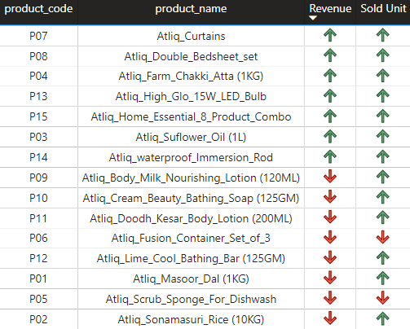
Product Insights
Despite a 25% off promotion, sales of P06 and P05 decreased.
Following promotions, sales of all other products increased, with 7 products exceeding their pre-promotion revenue.

Slide 23
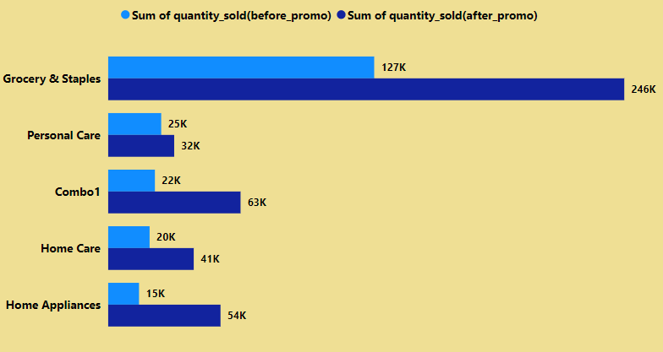
Category Insights
Home Appliances sales increased almost 400% after promotions followed by Combo1 with almost 300%.
The impact of promotions on Personal Care sales was minimal.

Slide 24
Conclusion
Chennai and Bengaluru were the top two cities both in terms of Revenue and Sales, but the highest revenue generated store is “STMYS-1” from Mysuru.
IR % and ISU % has a positive correlation, thus if sales increases eventually revenue increases and vice versa.
As Buy One Get One Free is preferred over a 50% discount, it is better to convert the 50% OFF into BOGOF which will also increase the sale effectively.
Promotion type should be changed for Atliq_Fusion_Container_Set_of_3 and Atliq_Scrub_Sponge_For_Dishwash, since 25% OFF is not effective on these products.
Sales of personal care products increased after promo but failed in terms of revenue.

